Slide 1
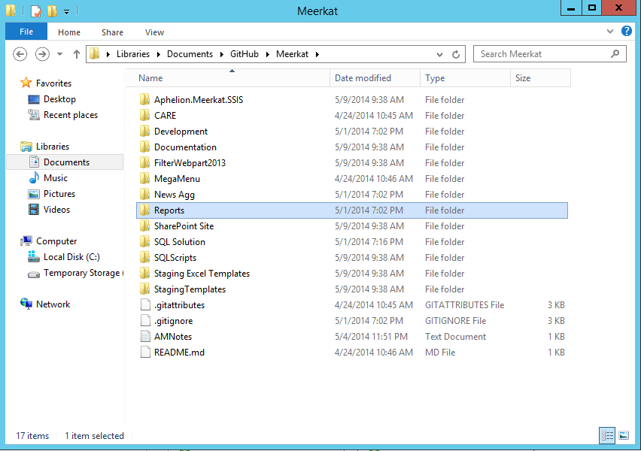
Access the Meerkat folder under Github and open the Reports folder.

Slide 2
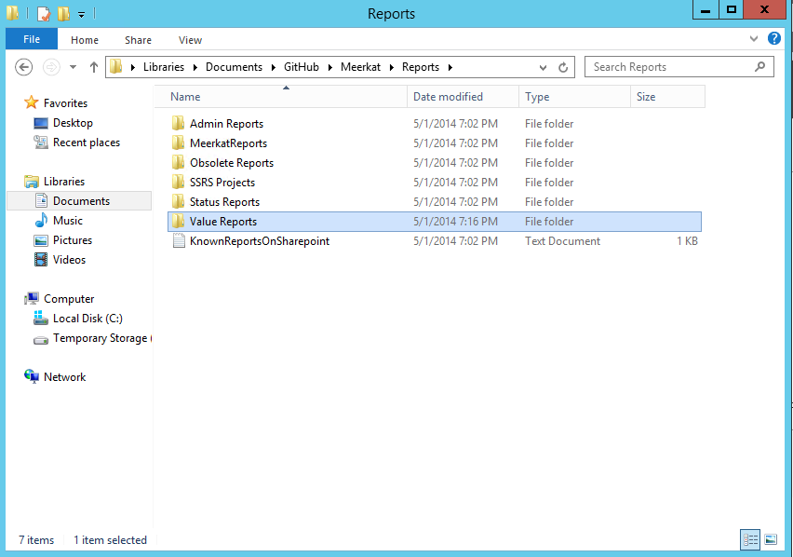
Once you’ve opened the Reports, you can open either the Admin Reports, Status Reports or Value Reports folder. The process is the same.

Slide 3
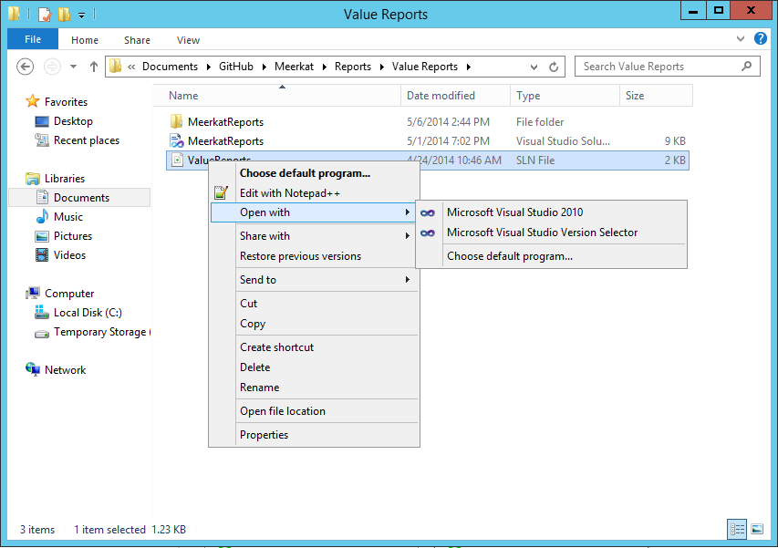
We open the Value Reports folder and right click on the Value Reports solution file and the select Open With and then click on Visual Studio 2010.

Slide 4
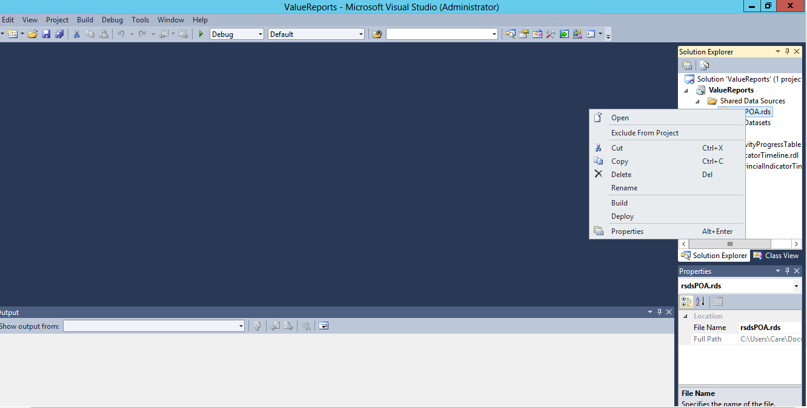
Right click on the shared data source and click open.

Slide 5
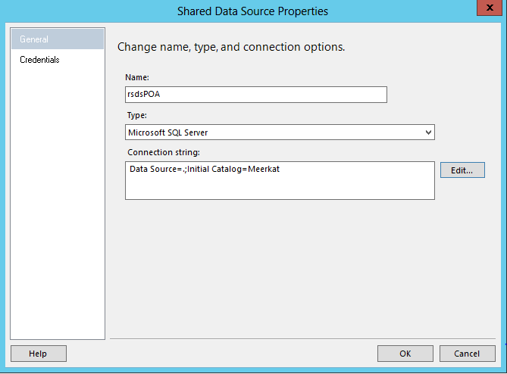
If the data source connection string needs to be changed to reflect the right database server name and database, click edit.

Slide 6
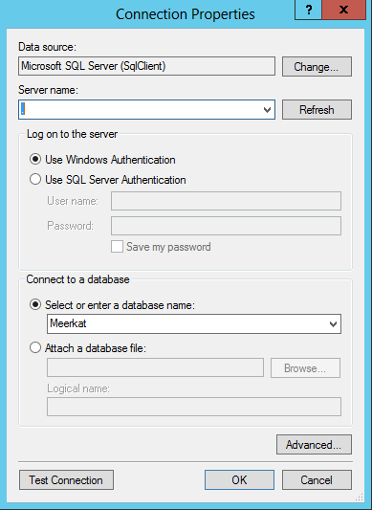
Make sure the server name and the database name are set to the right values then click on test connection to see if it will work. If it does, click ok.

Slide 7
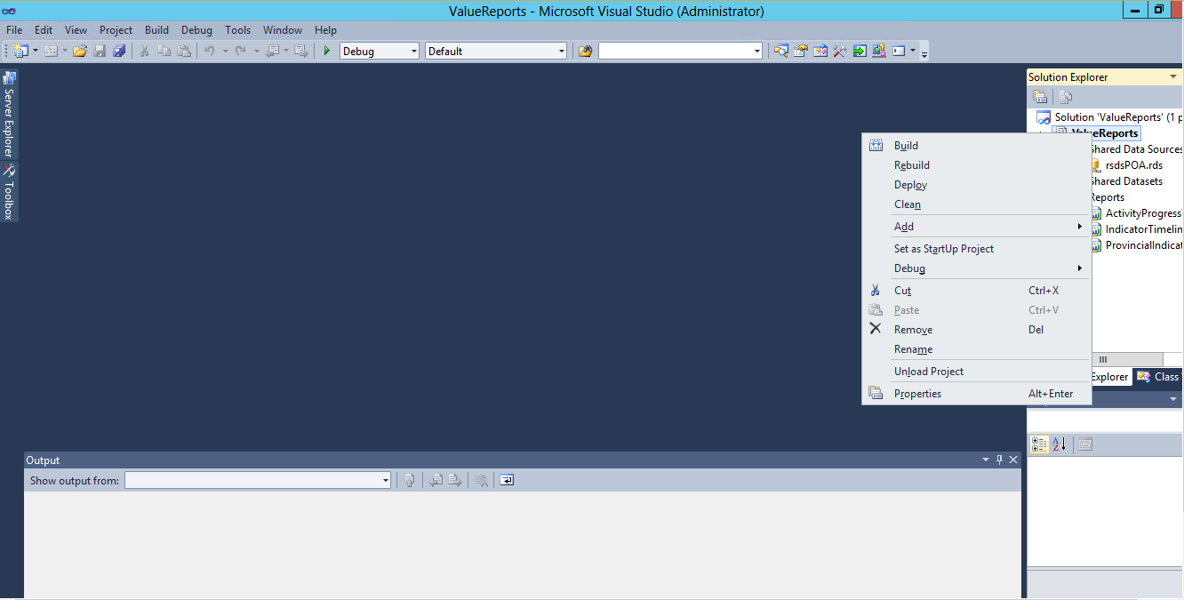
Right click on the name of the project under the solution name and select properties from the menu.

Slide 8
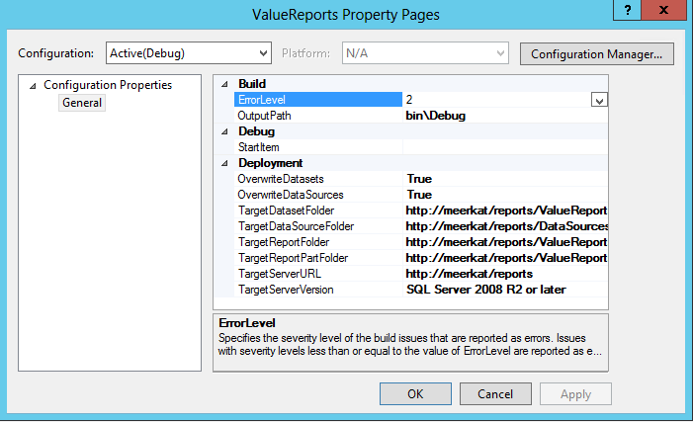
Edit the urls to reflect the right path to your system. In most cases all you need is to edit the first part.

Slide 9
Right click on the project name again and this time select deploy to deploy the reports to SharePoint. If you’re asked for credentials, input those that work on SharePoint.

